Slide 1
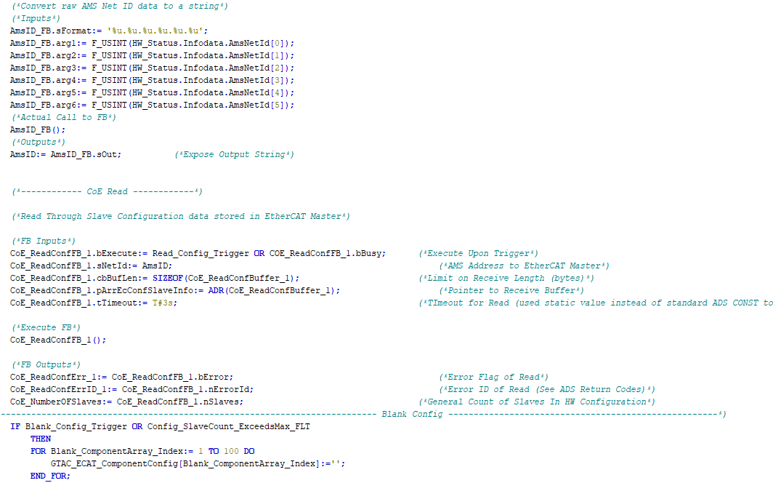

Internal Training:
PostgreSQL Server Extension

Slide 2
Prerequisites
This document is intended to help, in a self-directed manner, navigate through our PostgreSQL Server Extension package built for our TcHmi based UI and assumes the following:
You have setup of your local PC environment as per the IC Setup Guide contained in the SSCC610 machine package with:
XAE 4024.55 (in addition to .22)
TcHmi TE2000 (TcHmi Engineering)
TcHmi TF2000 (TcHmi Server)
Postgres / pgAdmin (Database / Database administrative tool)
Successfully deployed FW level SSCC610 locally on the above environment
Completion of all previous GTAC Internal Controls Training
Visual Studio 2022 is installed on your PC (check with your manager and I.T. to ensure VS 2022 is applicable / allowable in terms of Microsoft licensing agreements)

Slide 3
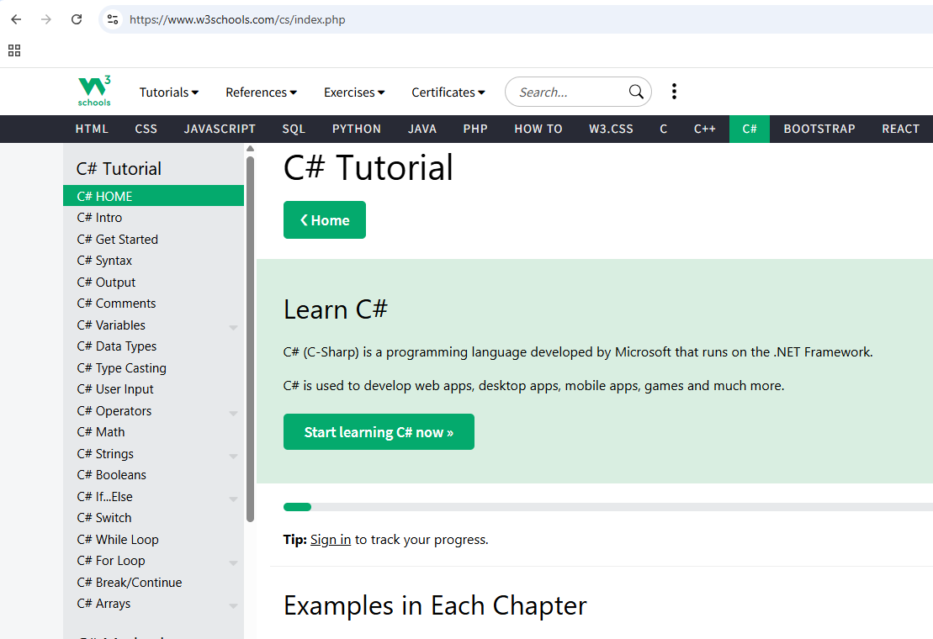
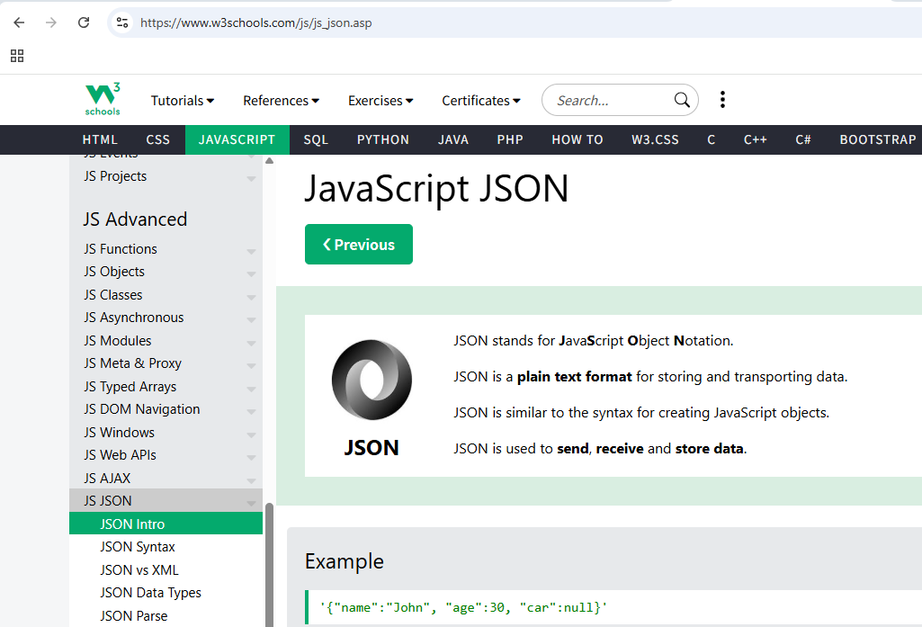
Prerequisites
Our Server Extension is built primarily using the C# Language
You will also see use of JSON files for general configuration
W3 schools offers great tutorials for both C# and JSON if you are unfamiliar

Slide 4

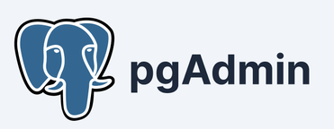
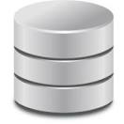


General Topology
Postgres
Database
Server
pgAdmin is an
administrative tool
Used to configure the
Postgres Database
GTAC TcHmi Machine UI (with GTAC PostgreSQL Server Extension)
Administrative
Commands
Bi-Directional
Data

Slide 5
General Topology
Postgres Database
Server
GTAC PostgreSQL
Server Extension
GTAC TcHmi
Machine UI
Bi-Directional
Data
Bi-Directional
Data

Slide 6
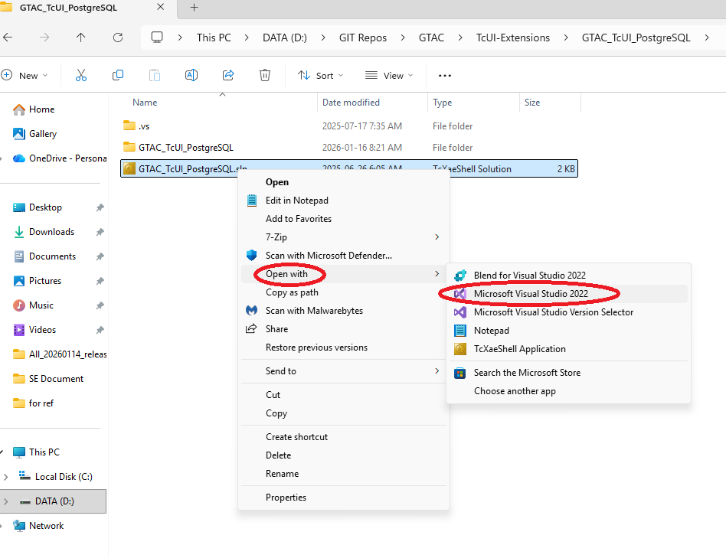
General Layout of the SE
The GTAC PostgreSQL Server Extension
can be opened, edited and packaged using Visual Studio 2022
(version 17.14.25 used in all the following examples)

Slide 7
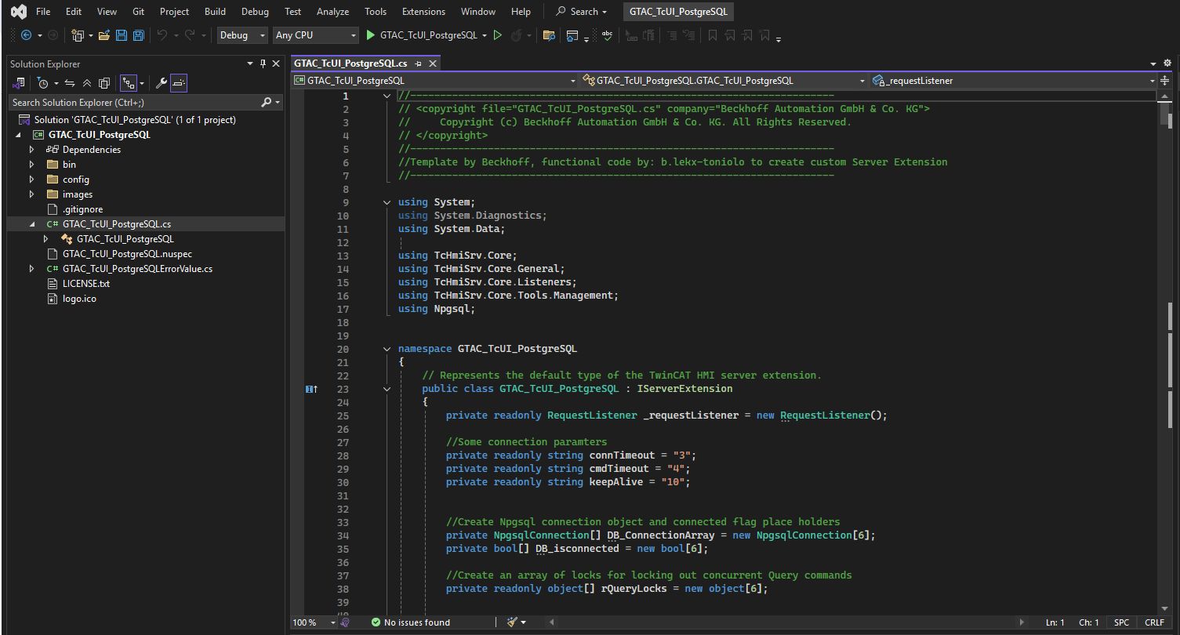
General Layout of the SE
Here we see the GTAC PostgreSQL Server
Extension, opened in VS 2022
(the GTAC_TcUI_PostgreSQL.cs file opened in the example below)

Slide 8
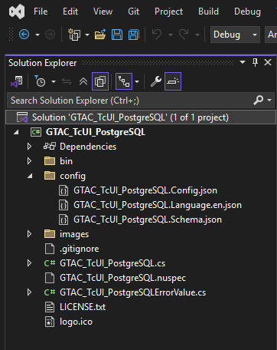
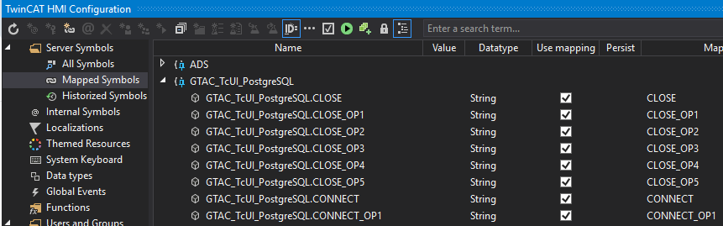
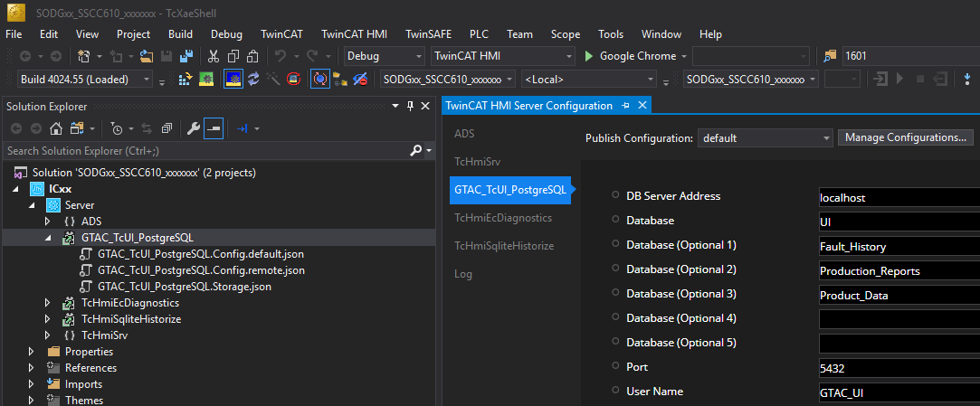
File Breakdown
Let’s have a look at some of the files contained in the Package:
GTAC_TcUI_PostgreSQL.config.json -> A JSON file used to describe the symbol interface
that will be used for our TcHmi UI and the PostgreSQL SE to communicate thru. Symbols described in this file will show up in the TcHmi project similar to PLC symbols (see right)
GTAC_TcUI_PostgreSQL.Schema.json -> This file describes the SE’s configuration interface that will show up in XAE when you click on the SE. This allows the TcHmi developer to customize aspects of the SE such as the database server location and port etc. (see right)
GTAC_TcUI_PostgreSQL.Language.json -> In this file we can see English language locales for the configuration points set out in the GTAC_TcUI_PostgreSQL.Schema.json file (see right)
GTAC_TcUI_PostgreSQL.cs -> This is the source code file. The bulk of the functional code is contained in this file. This is generally where you will spend most of your time.
GTAC_TcUI_PostgreSQL.nuspec -> This is an XML based manifest file for how the source code, resultant build files and dependencies get packed into a NuGet package. The NuGet package is what is brought into our TcHmi Machine UI solution. NOTE: using a nuspec file is now considered an older method, largely replaced by information in the .csproj file for SDK packages

Slide 9
GTAC_TcUI_PostgreSQL.cs
Since the bulk of the functional code is contained
in the GTAC_TcUI_PostgreSQL.cs file, lets have a closer look!
The file can be primarily broken down into three parts:
Using Directives
Class Declaration / Definition
Application Specific Methods
The OnRequest method
Please note that all the methods in 3 and 4 are contained in the
GTAC_TcUI_PostgreSQL class (2).

Slide 10
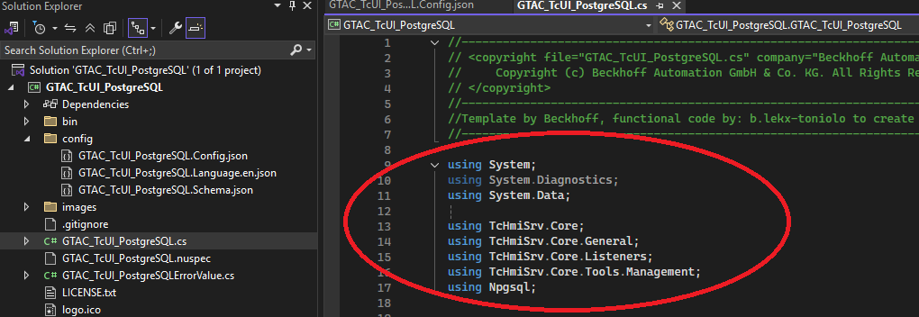
GTAC_TcUI_PostgreSQL.cs
1. Using Directives
The “Using Directives” of the GTAC_TcUI_PostgreSQL.cs file lists out other namespaces (think dependencies) we will leverage in our code

Slide 11
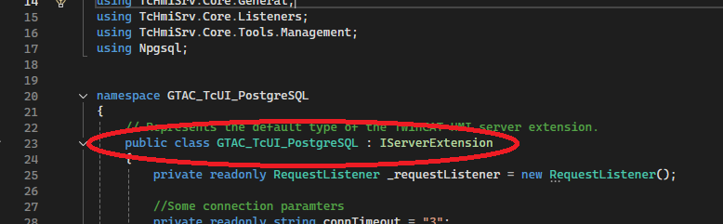
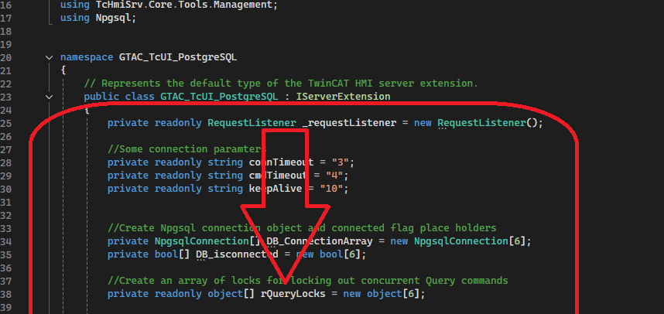
GTAC_TcUI_PostgreSQL.cs
2. Class Declaration / Definition
The term “Class” may be new to you. You can think of a class like an FB in TwinCAT structured text. A class contains variables, methods (IE actions) and functional code just like an FB.
In our case, as is typical in C#, we declare and define the class in the same block of code.
This is the class declaration ->
Technically, everything else in the class
(which in our case is the rest of the
file contents) is the class definition ->

Slide 12
GTAC_TcUI_PostgreSQL.cs
3. Application Specific Methods
The Application Specific Methods are the real nuts and bolts of how our server extension works. They are the functional code that end up being called when the TcHmi UI accesses a Server Extension symbol.
The full list of methods is too large for the scope of this document. You are encouraged to study the code in depth to gain a good understanding of how each method works.
Some methods of particular interest are: “Connect_Base”, “Read_Base”, “Write_Base” where the heavy lifting is done.
Please note that some typical C# best practices were not used during the development of this SE in such cases where code style more typical of what you may have seen in TwinCAT were used. This was done to help the migration from one environment to the other.

Slide 13
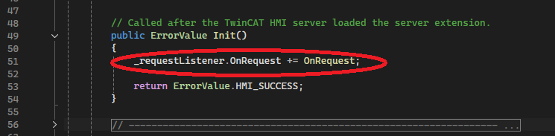
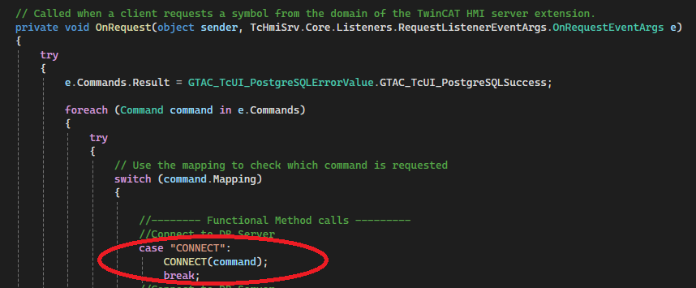
GTAC_TcUI_PostgreSQL.cs
4. OnRequest Method
The OnRequest Method is the last method in the GTAC_TcUI_PostgreSQL class. It is a “callback” method registered against the Server Extensions request listener. So, when the TcHmi UI makes a request to the server extension by accessing one of the Servr Extension symbols, this OnRequest method is executed. The symbol that was accessed in the request by TcHmi contains a “command” object. The command object contains a string that identifies which symbol was accessed.
Here is where we register the OnRequest method to the request listener ->
For example, if the “CONNECT” symbol is accessed in the machine’s TcHmi UI, the request listener detects this event and passes the associated command object — which includes the command mapping string (in this case, "CONNECT") — to the server extension ->
Inside the server extension, the OnRequest method processes the incoming command by checking the command’s mapping string in a switch statement.
When the "CONNECT" mapping is detected, the OnRequest method calls the corresponding CONNECT method and passes the command object to it. The CONNECT method then performs the necessary operations and uses the command object to send data or results back to the TcHmi client ->

Slide 14
More to come
Still in the works

Slide 15

Thanks for your time

